Slide 1
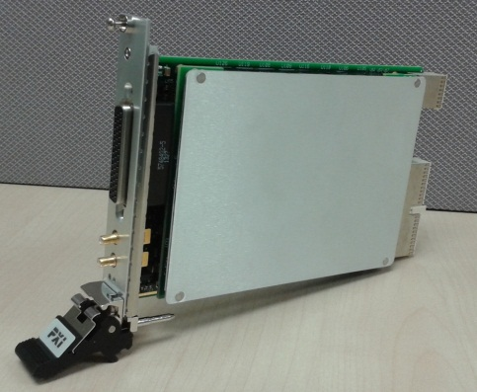

M9188A
Training for Early Adopters

Slide 2
Agenda
Hardware Installation Instruction
Software Installation Instruction
M9188A in a brief
Soft Front Panel
Example Programs
Download files at ftp://ftp.agilent.com/TDMS/New%20Folder/M9188A/

Slide 3
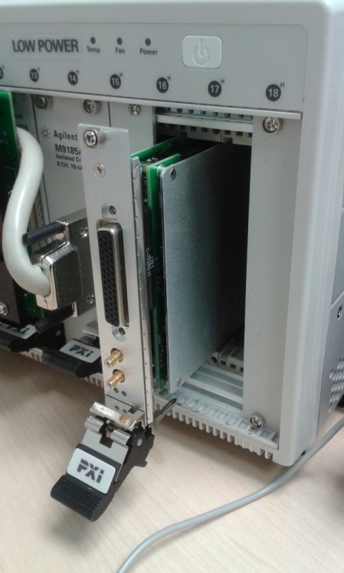
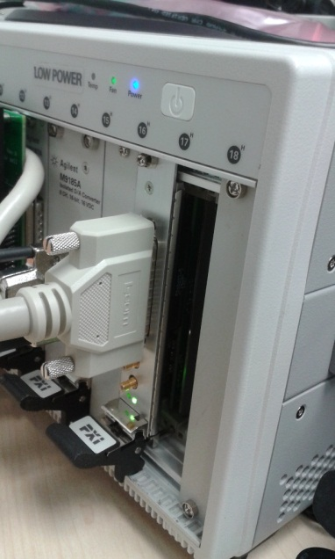
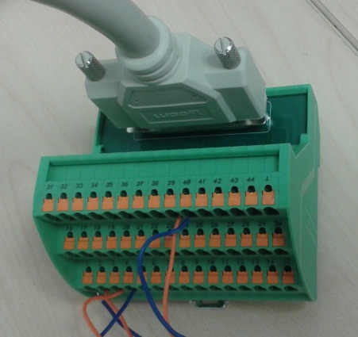
Hardware Installation Guide
Turn off PXI Chassis and PC.
Slot in M9188A module, see figure 1
Connect the cable at both ends, one side to the M9188A module, the other end at the terminal block, see figure 2
Turn on PXI chassis, then after 3 seconds, turn on IPC.
Figure 1
Figure 2

Slide 4
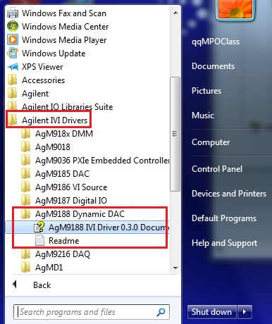
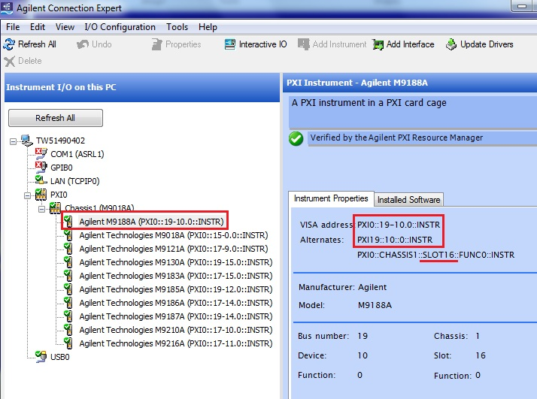
Software Installation Guide
Install the M9188A installer according to 64-bit or 32-bit OS.
32-bit OS : AgM9188-x86_0.3.0.0.msi
64-bit OS : AgM9188-x64_0.3.0.0.msi
During installation, it might prompt user to manually install some files, please select “Accept” and continue, see Figure 3
Right click in my computer, select Properties > Device Manager. You will see a PCI device in the list which shows problem. Right click on the PCI device > select update driver and browse to the folder “VXI inf driver” (unzip this folder first), then select ok/ continue. The item should be able to ready to be used.
Open Agilent Connection Expert / NI Max, it should automatically detect the module. See Figure 4, the modules is detected in slot 16 with address of “PXI19::10::0::INSTR”
Figure 3
Figure 4

Slide 5
M9188A in a Brief - 1
16 Channels/module in one single PXI slot
4 isolated banks with 4 channels each
Unipolar output DC Voltage up to +30V and Current pulse up to +20mA
Simultaneous channels
16 bits of resolution up to 500KSa/s output waveform update rate
No remote sensing
Memory Size 1MB/Channel
PXI trigger capabilities
PXI 10MHz
PXI TTL/trigger
PXI star trigger
M9188A Specification

Slide 6
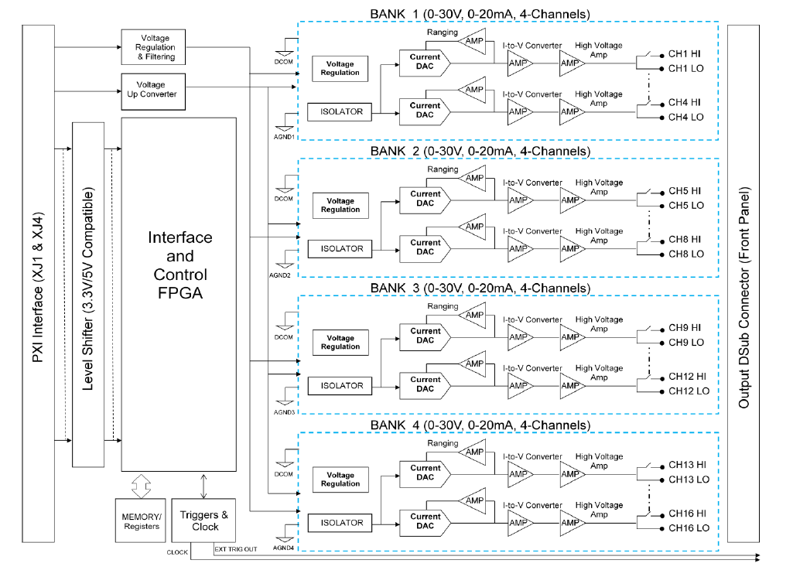
M9188A in a Brief - 2
M9188A Block Diagram

Slide 7
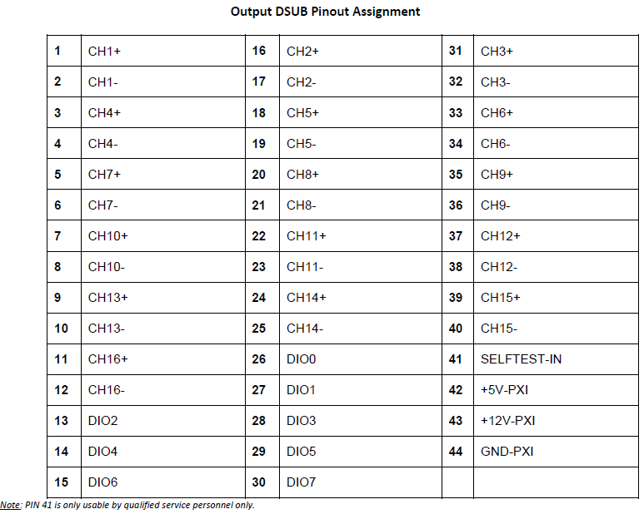
M9188A in a Brief - 3
For complete M9188A user information, please refer to user manual

Slide 8
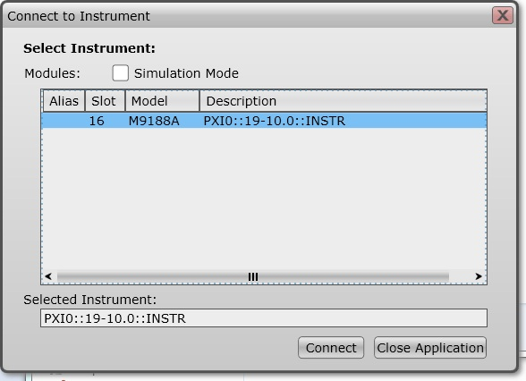
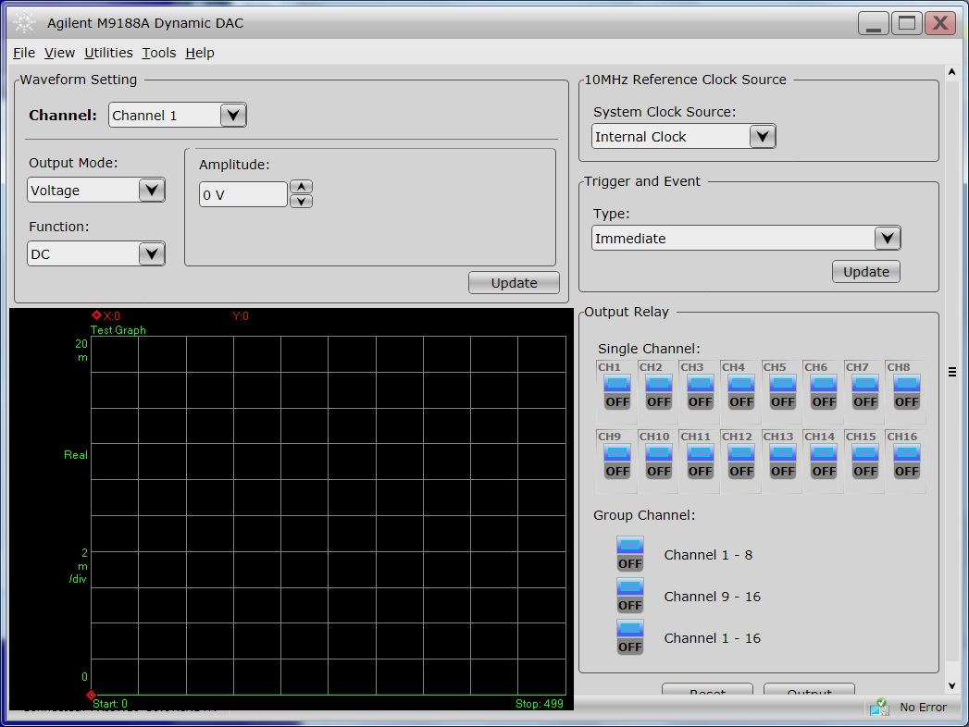
Soft Front Panel - 1
1) Double click on the
AgM9188SFP.exe
2) Select the correct instrument and then click connect

Slide 9
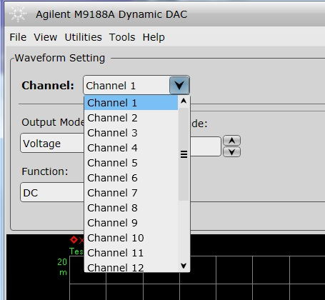
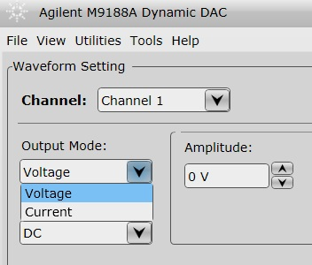
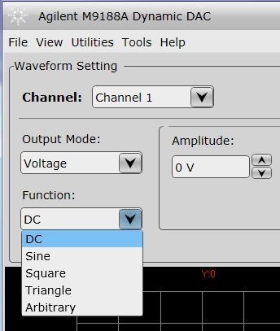
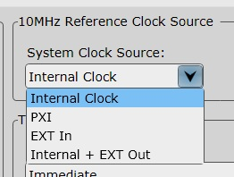
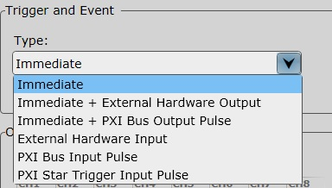
Soft Front Panel - 2

Slide 10
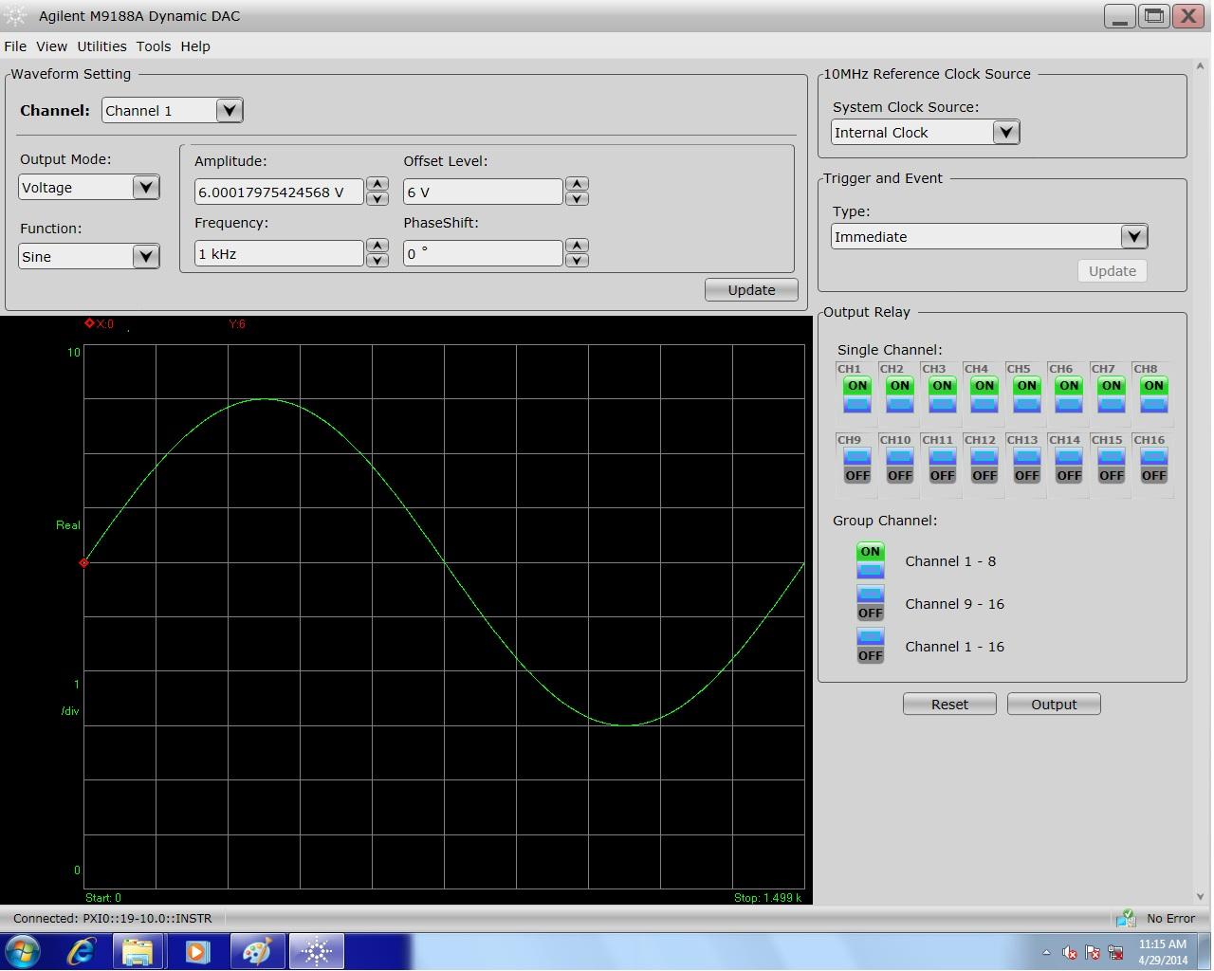
Soft Front Panel – 3
Normal waveform

Slide 11
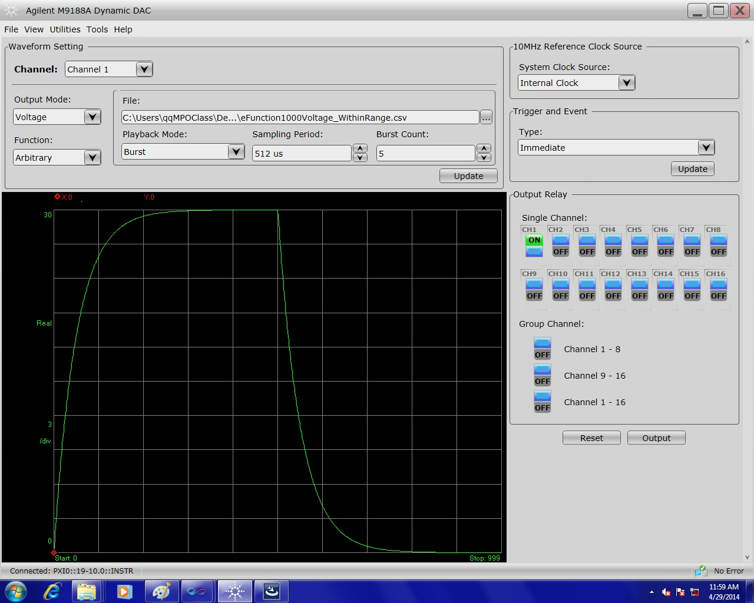
Soft Front Panel - 4
Arbitrary waveform

Slide 12
M9188A Basic Operation
Initialize the module
Configure the waveform / trigger
Enable group / individual
Send Trigger
Initiate measurement
When done, close the module

Slide 13
Example Programs
We have prepared a few programming examples at FTP for .NET and Matlab. Please refer to the folders for more information.
To make these examples working with hardware, remember to
Change the address of the PXI modules
Change Simulation = true

Slide 15

Thank You!

